Slide 1
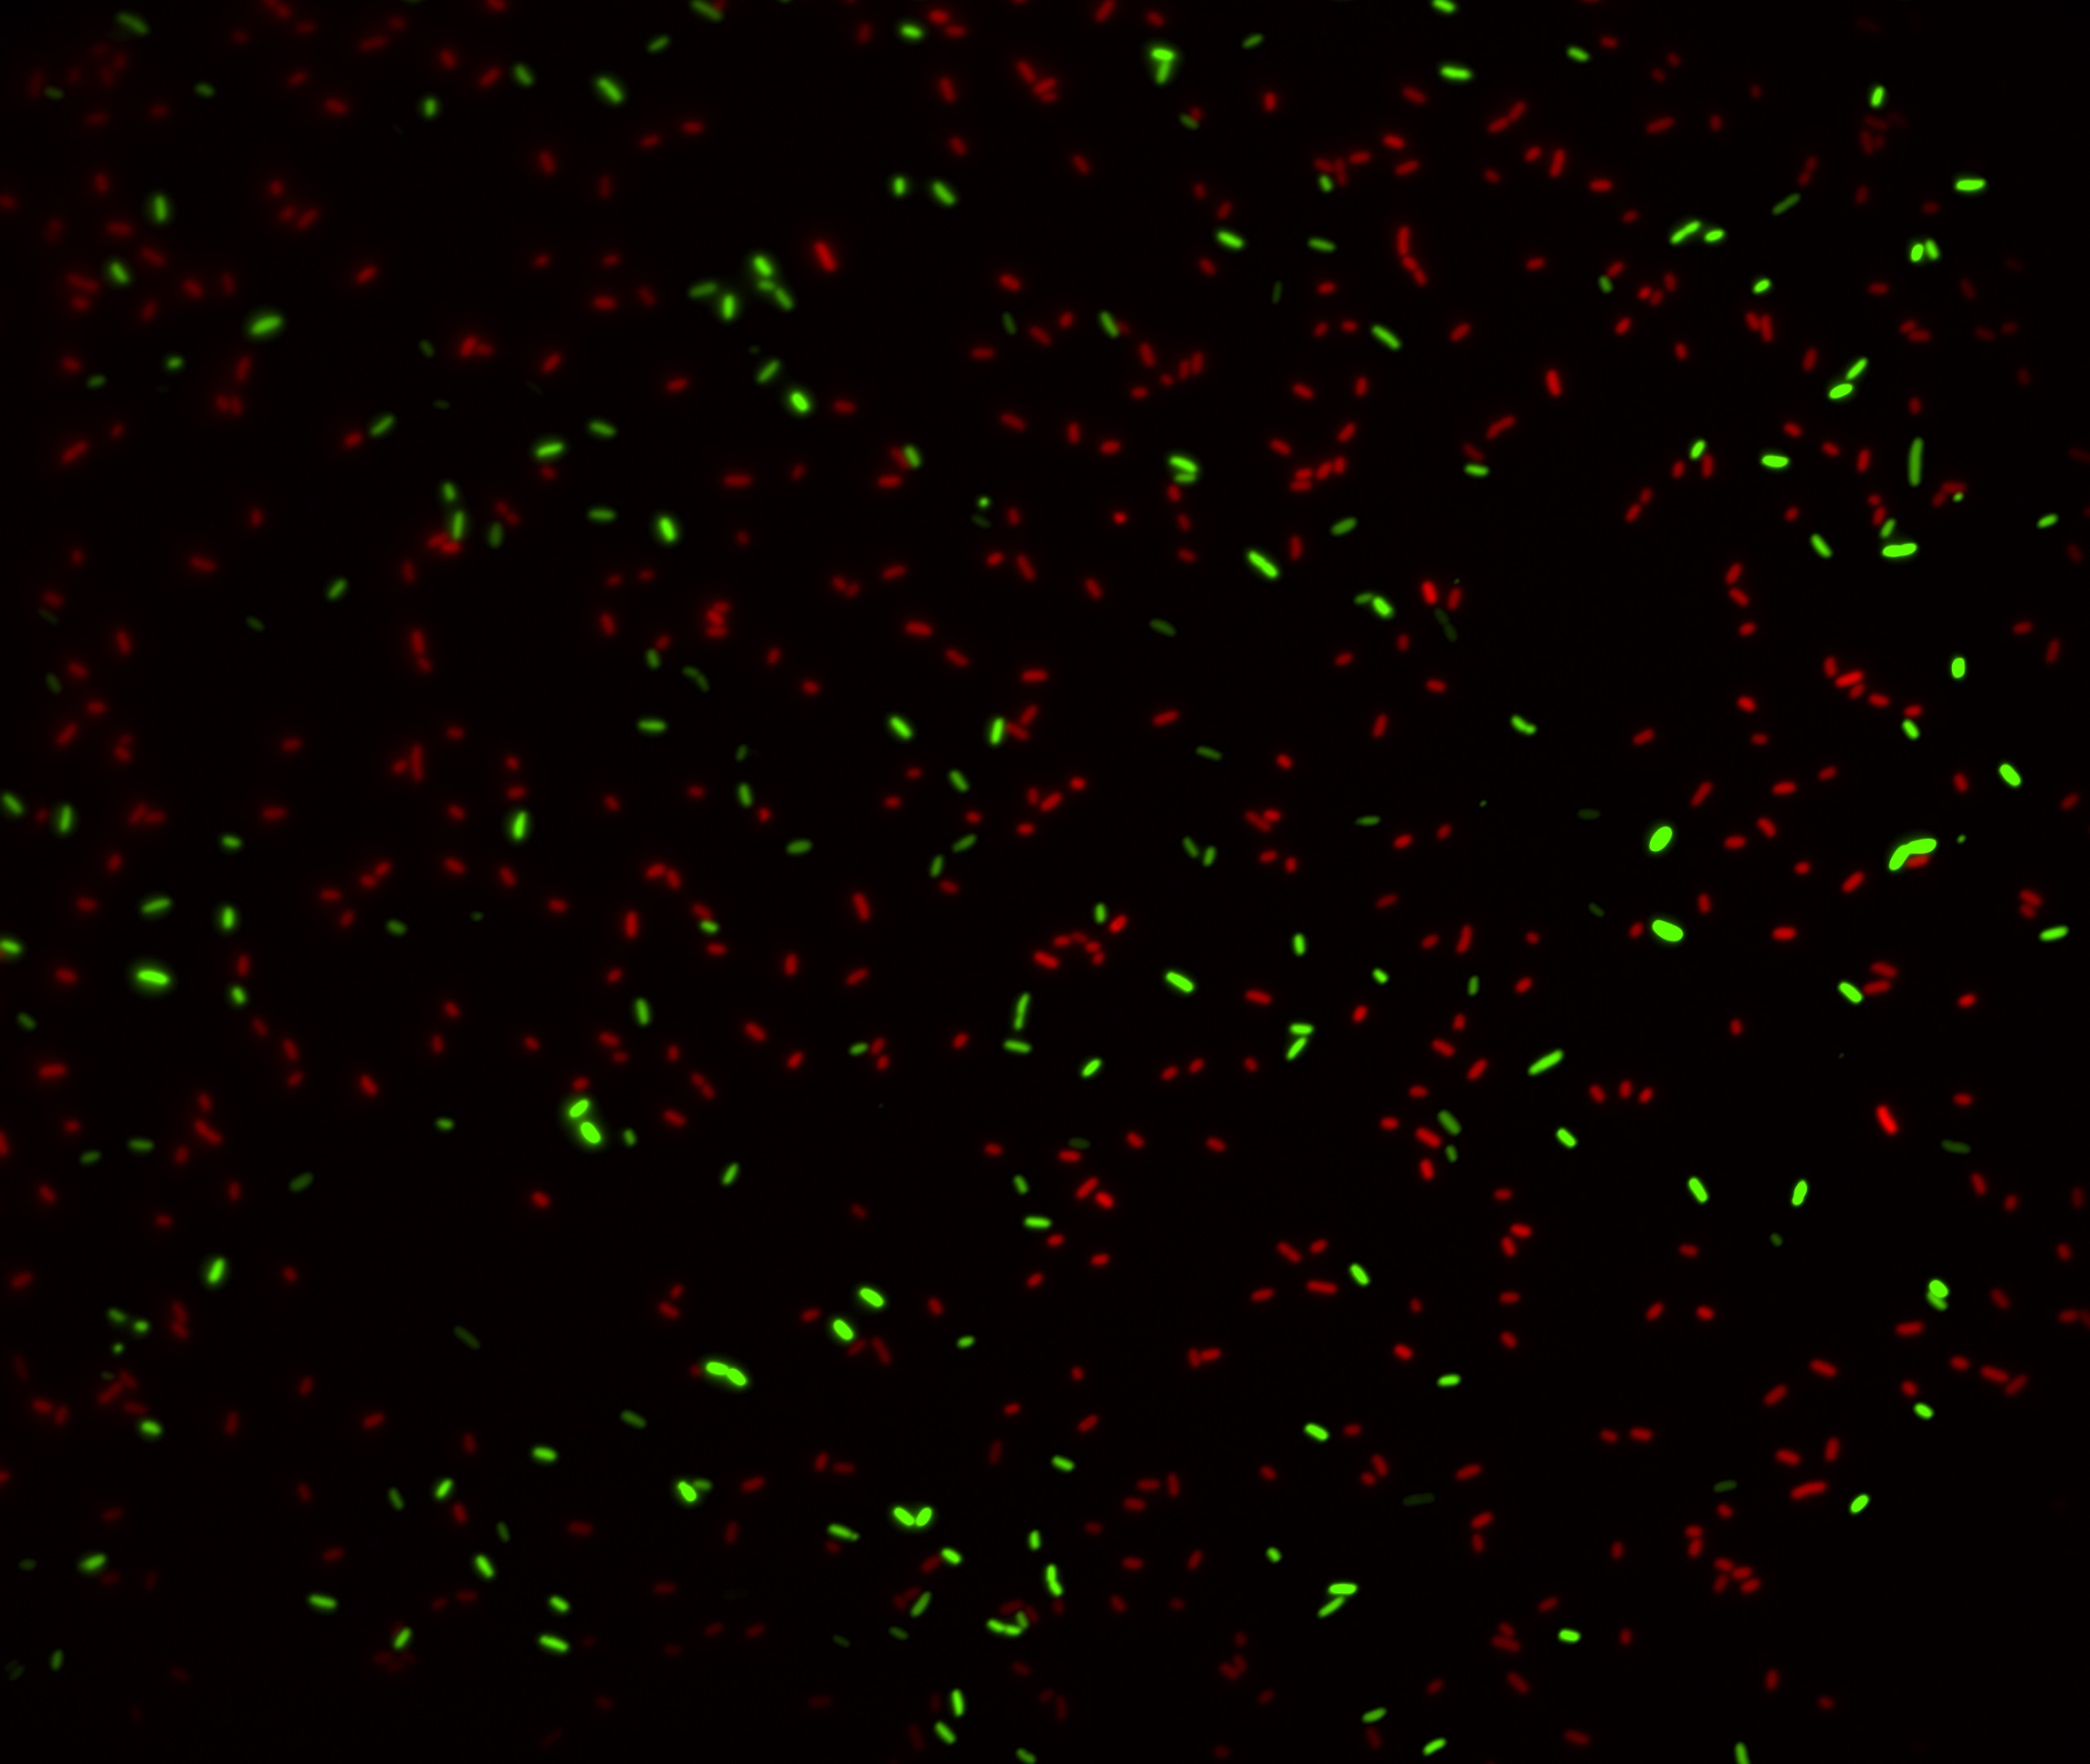
­­­­­The Evolution of Stress-Induced Mutagenesis: Causes and Consequences Yoav Ram PhD Seminar Tel-Aviv University 6 April 2016

Slide 2
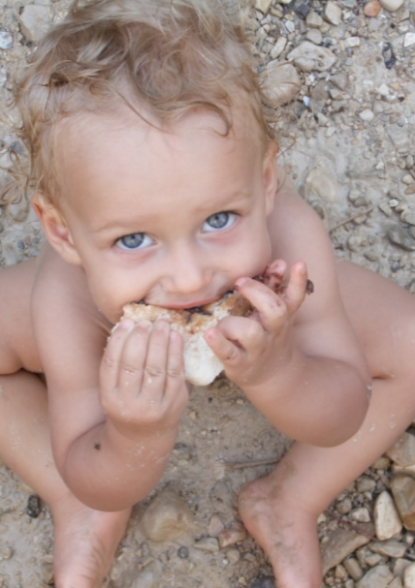
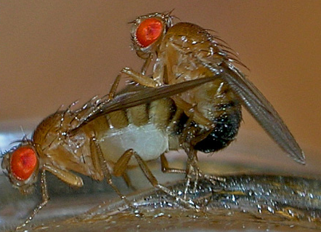
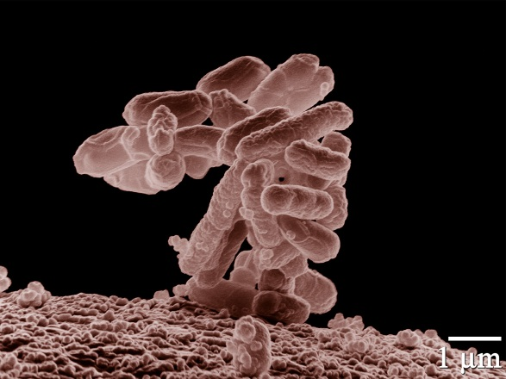
Variability in mutation rates
Between species
Average number of measurable mutations
per genome per generation
Flies: 0.455
Keightley et al. Gen Res 2009
Humans: 41
Lynch, PNAS 2010
Bacteria: 0.0004
Wielgoss et al. G3 2011

Slide 3
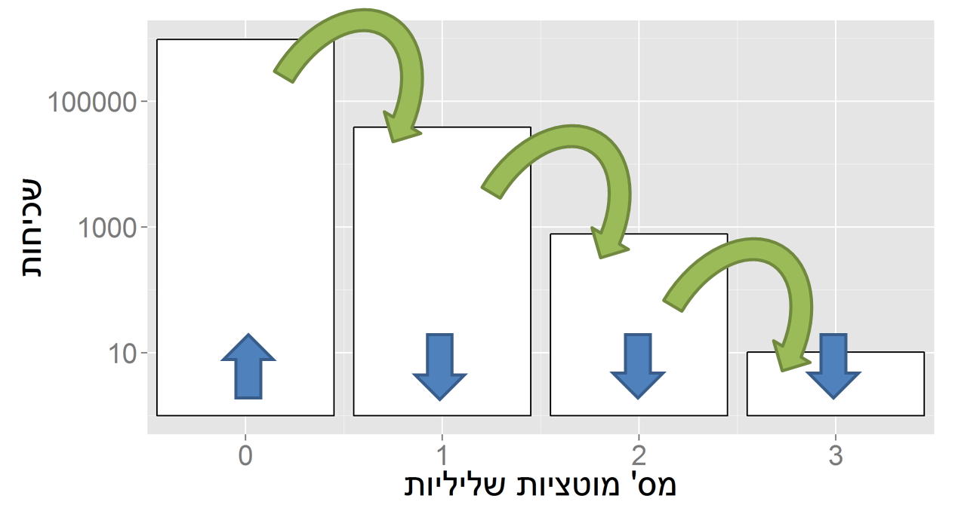
Evolution in a constant environment
Directional selection without change
A balance between mutation and selection
Frequency
# Deleterious mutations

Slide 4
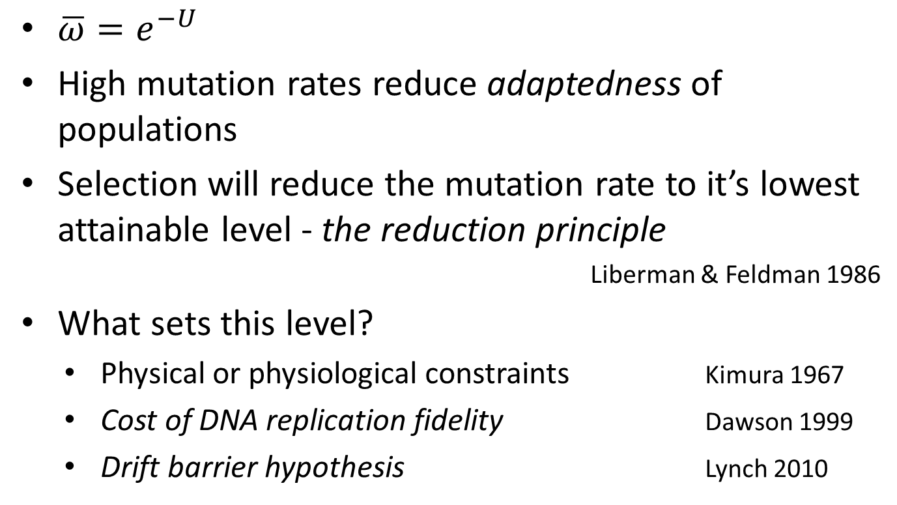
Mutation-selection balance
$\overline{ω}=e^{−U}$
High mutation rates reduce adaptedness of populations
Selection will reduce the mutation rate to it’s lowest attainable level - the reduction principle
Liberman & Feldman 1986
What sets this level?
Physical or physiological constraints Kimura 1967
Cost of DNA replication fidelity Dawson 1999
Drift barrier hypothesis Lynch 2010

Slide 5

Evolution in a changing environment
In changing environments rapid adaptation can be favored by natural selection (adaptability)
The mutation rate must balance between adaptability and adaptedness
Leigh 1973

Slide 6
Variability in mutation rates
Within species
Mutation rate in 69 natural populations of E. coli Matic et al. 1997

Slide 7
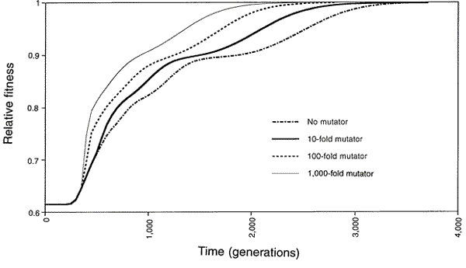
Adaptation with mutator alleles
x100
x10
x1
x1,000
Taddei, et al. Nature 1997

Slide 8
Variability in mutation rates
Within individuals
DNA polymerase error rate Lynch 2011

Slide 9
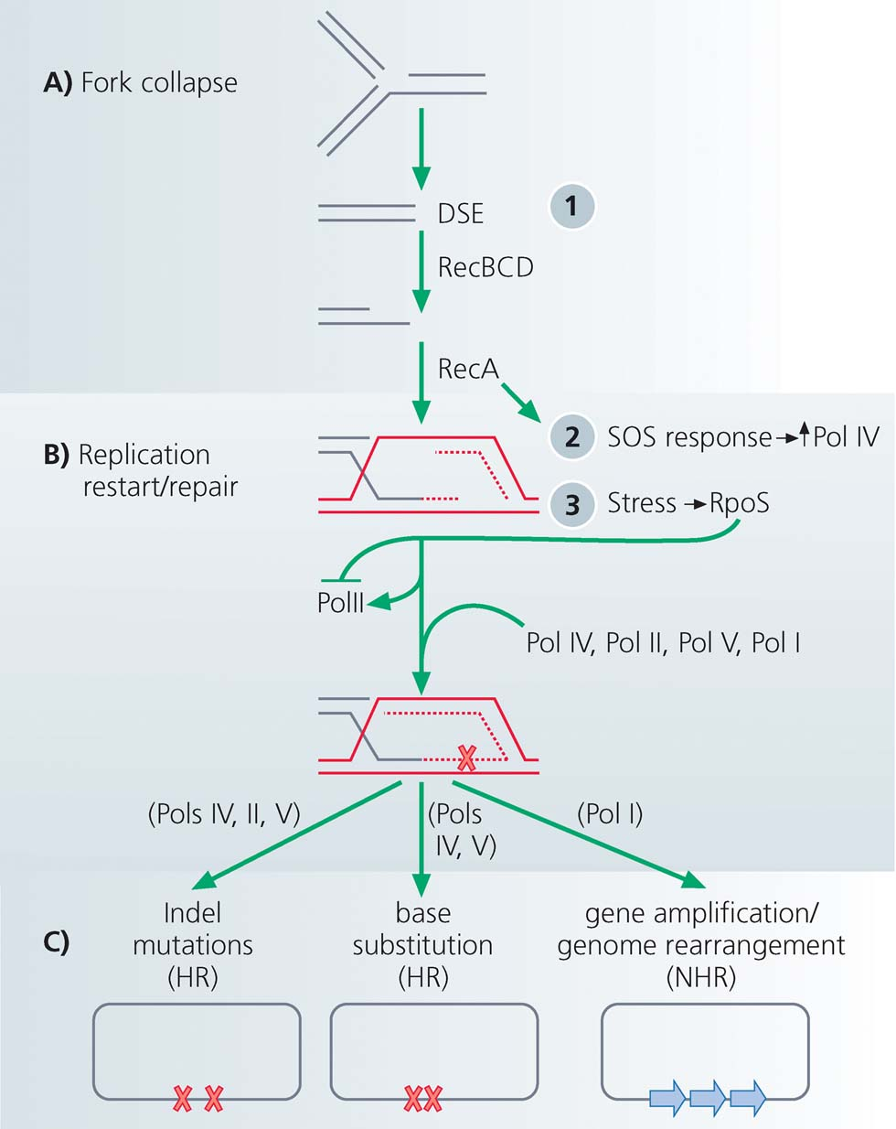
Stress-induced mutation
Rosenberg et al. 2012
In E. coli:
Error prone polymerase induced by stress responses:
SOS response
DNA damage
Starvation
Mismatch repair system
Other mechanisms:
Galhardo et al. 2007
Al Mamun, Science 2012
High-fidelity polymerase
Error-prone polymerases

Slide 10
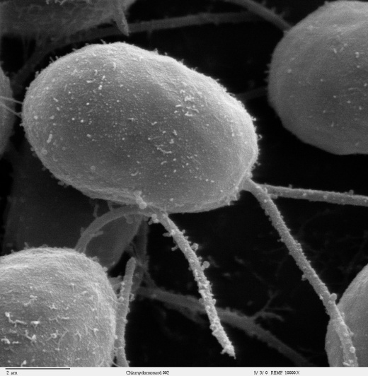
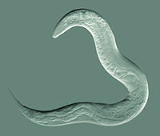
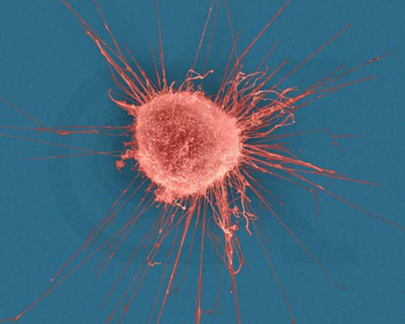

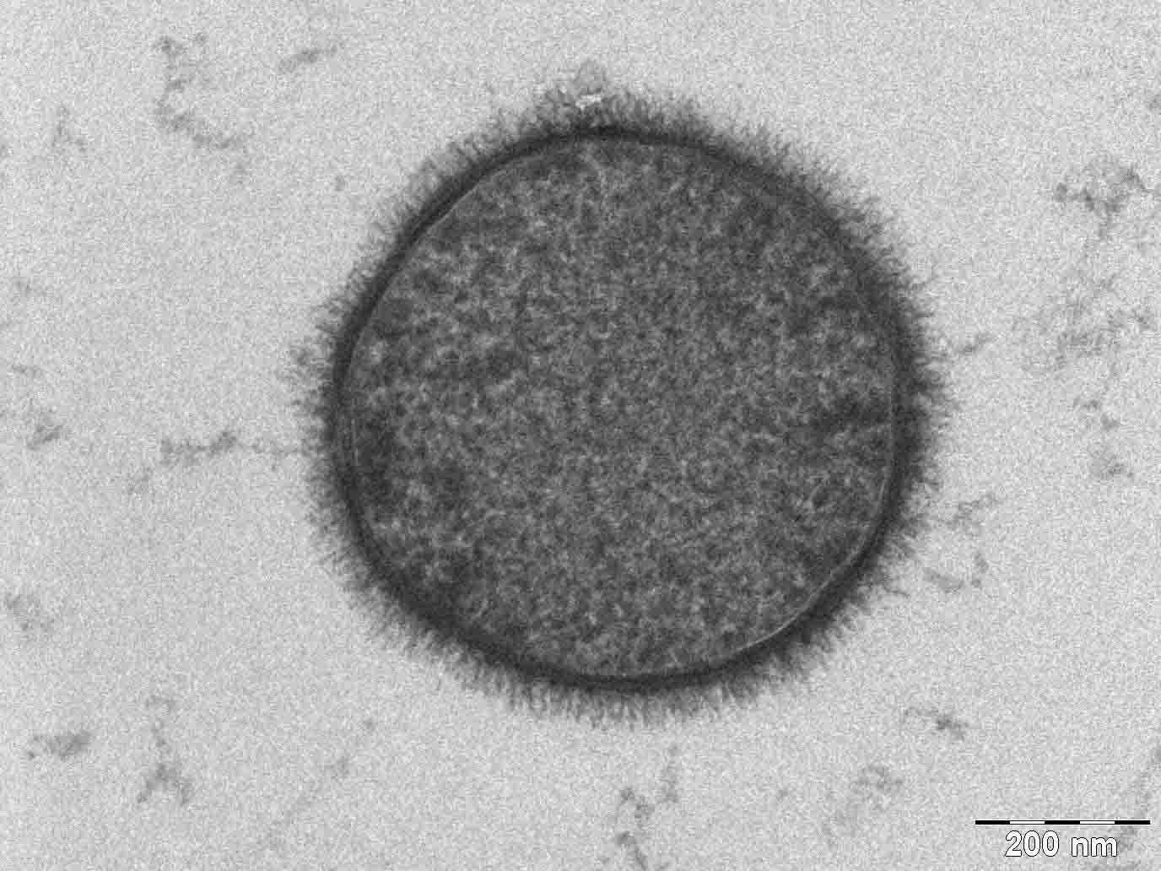
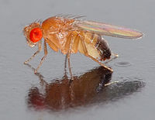
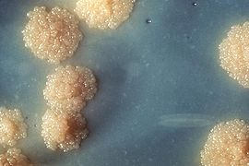
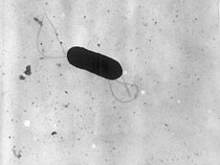
Evidence
Green algea
Nematodes
E. coli
Bacillus subtilis
Breast cancer cell
D. Melanogaster
M. tuberculosis
L. monocytogenes

Slide 11
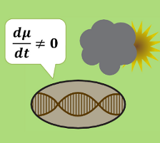
Evolution of stress-induced mutation
Null hypothesis
Mutagenesis is the by-product of stress
Alternative non-adaptive hypotheses
Cost of replication fidelity
Adaptive hypothesis
2nd order selection

Slide 12
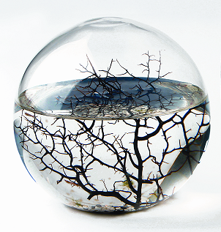
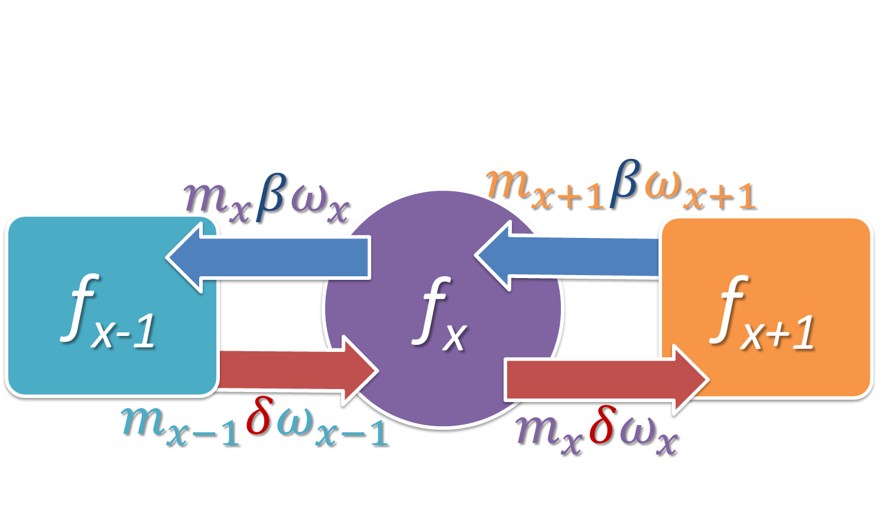
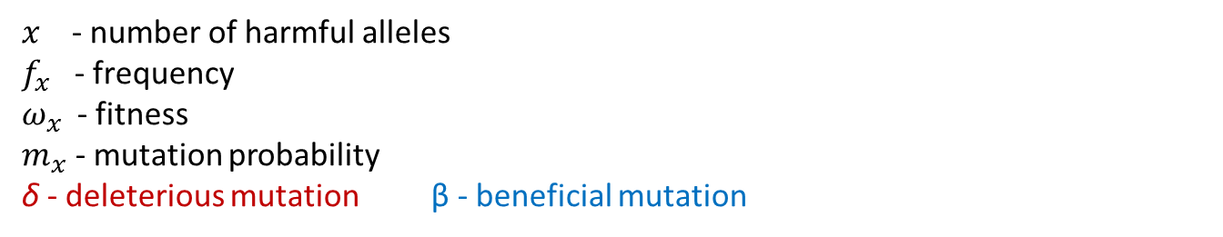
Constant environment
Selection against generation of deleterious mutations
$x$ - number of harmful alleles
$f_{x}$ - frequency
$ω_{x}$ - fitness
$m_{x}$ - mutation probability
δ - deleterious mutation β - beneficial mutation
Ram & Hadany, Evolution 2012

Slide 13
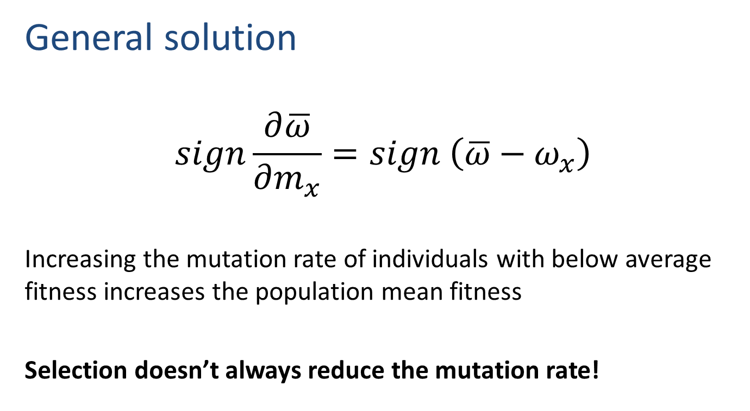
Constant environment
General solution
$$sign\frac{∂\overline{ω}}{∂m_{x}}=sign \left(\overline{ω}−ω_{x}\right)$$
Increasing the mutation rate of individuals with below average fitness increases the population mean fitness
Selection doesn’t always reduce the mutation rate!
Ram & Hadany, Evolution 2012

Slide 14

Rapidly changing environments
The Red Queen hypothesis (van Valen, 1973):
It takes all the running you can do,
to keep in the same place.
- Lewis Carrol, Through the Looking Glass
What happens when the environment changes frequently?

Slide 15

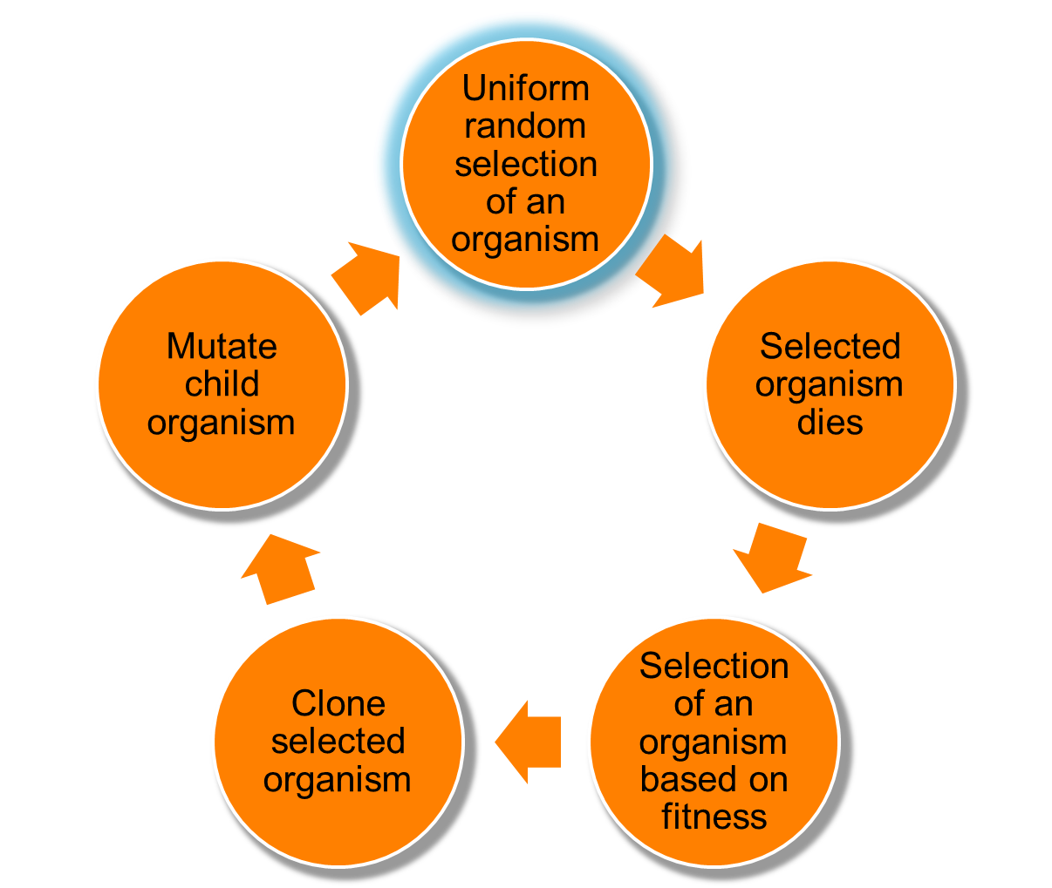
Changing environments
https://github.com/yoavram/proevolutionsimulation
Simulations
Moran process
Individual-based simulations
100,000 individuals
1,000 loci
Asexual, Haploid
Overlapping generations
No recombination
No segregation
No mutations at mutator locus
Environmental changes
Ram & Hadany, Evolution 2012

Slide 16
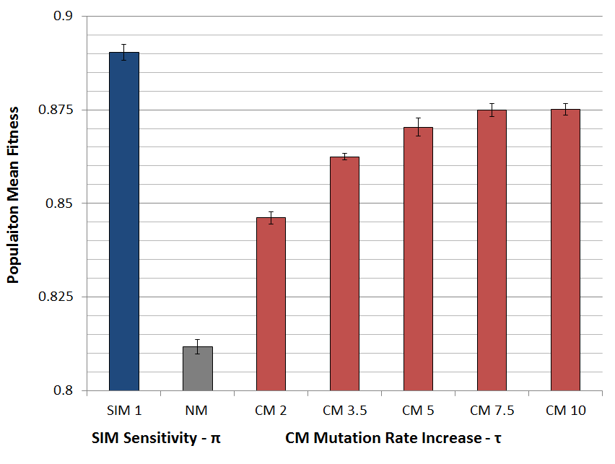
Populations with SIM are fitter
Ram & Hadany, Evolution 2012

Slide 17
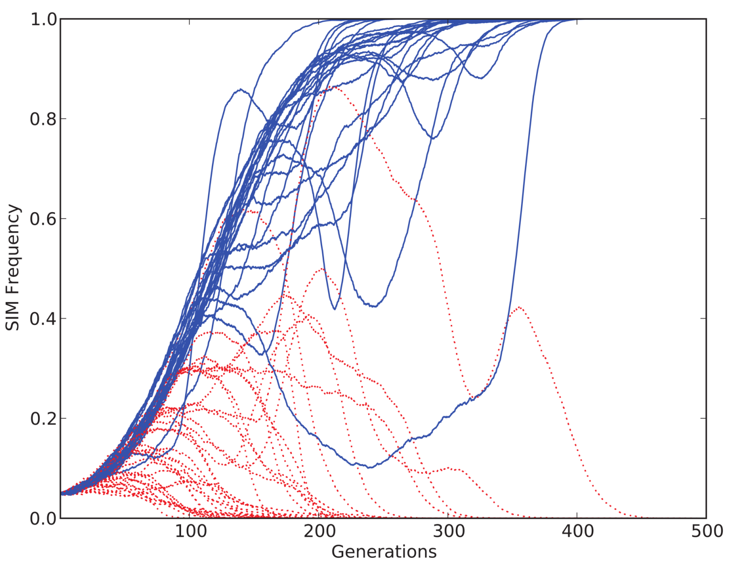
SIM wins competitions
Ram & Hadany, Evolution 2012

Slide 18
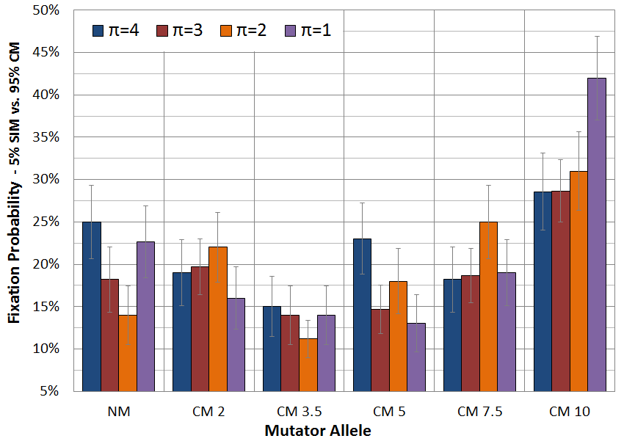
SIM wins competitions
Ram & Hadany, Evolution 2012

Slide 19
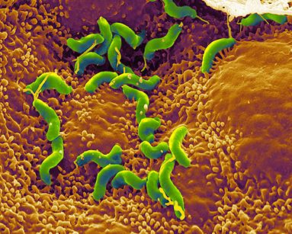
Conclusions
Stress-induced mutators evolve:
In constant & changing environments
2nd order selection can lead to the evolution of stress-induced mutagenesis in asexual populations
Selection for evolvability
H. pylori

Slide 20
In the presence of rare recombination
Recombination can:
Separate mutator from beneficial mutations
Increase non-mutator adaptation rate
Save constitutive mutator from deleterious mutations

Slide 21
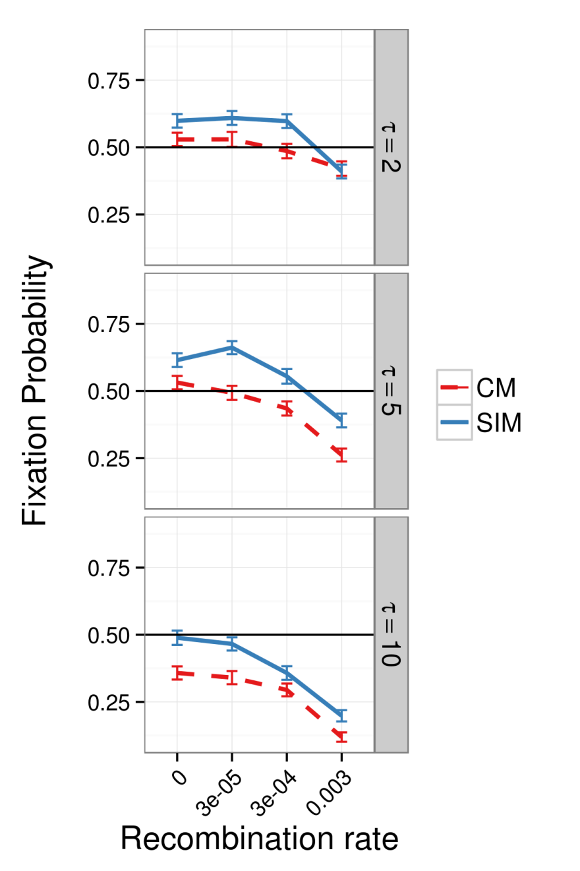
In the presence of rare recombination
Results suggest:
SIM > CM
SIM >= NM
As long as recombination is as not much stronger than mutations
Sexual populations??
Ram & Hadany, in preparation

Slide 22
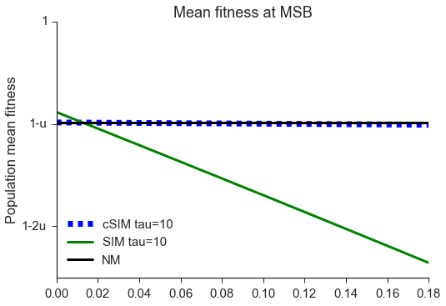
Stress-induced mutagenesis under uncertainty
Uncertainty
should you mutate?
SIM decreases mean fitness
Communication
Increase in mutation rate depends on population mean fitness
Allow robustness to noise
Uncertainty level
Gur-Dellus, Ram, and Hadany, in preparation

Slide 23
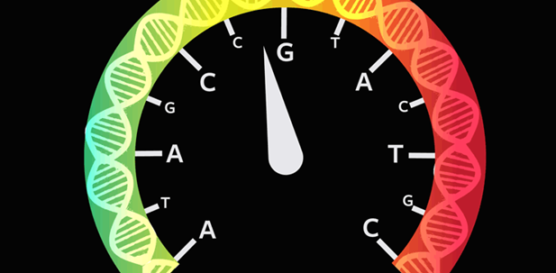
Consequences of Stress-Induced Mutagenesis
How does stress-induced mutagenesis
affect adaptation?
http://nautil.us/issue/34/adaptation/does-stress-speed-up-evolution

Slide 24
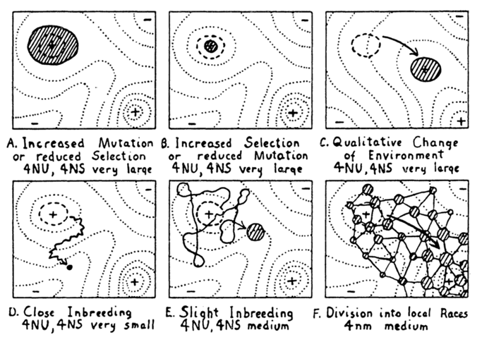
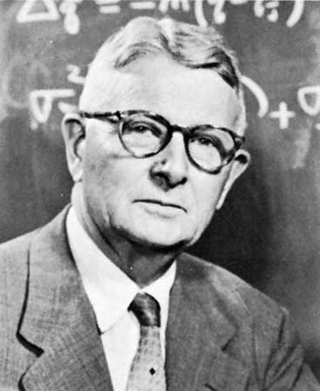
Adaptive peak shifts
Sewall Wright, 1931:
If a new adaptation requires several, separately deleterious mutations, how can it evolve?
Wright, Am. Nat. 1988

Slide 25
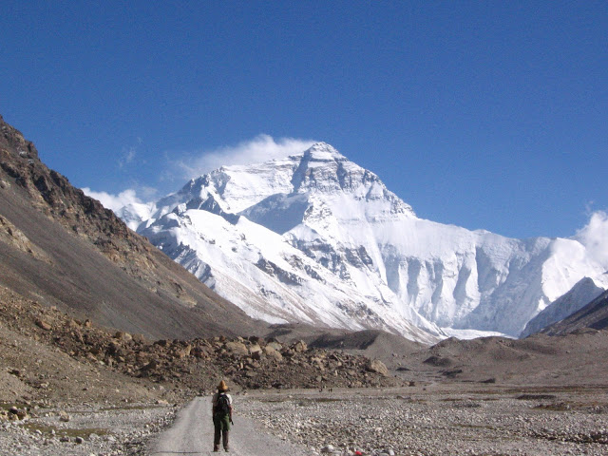
Simple landscape

Slide 26
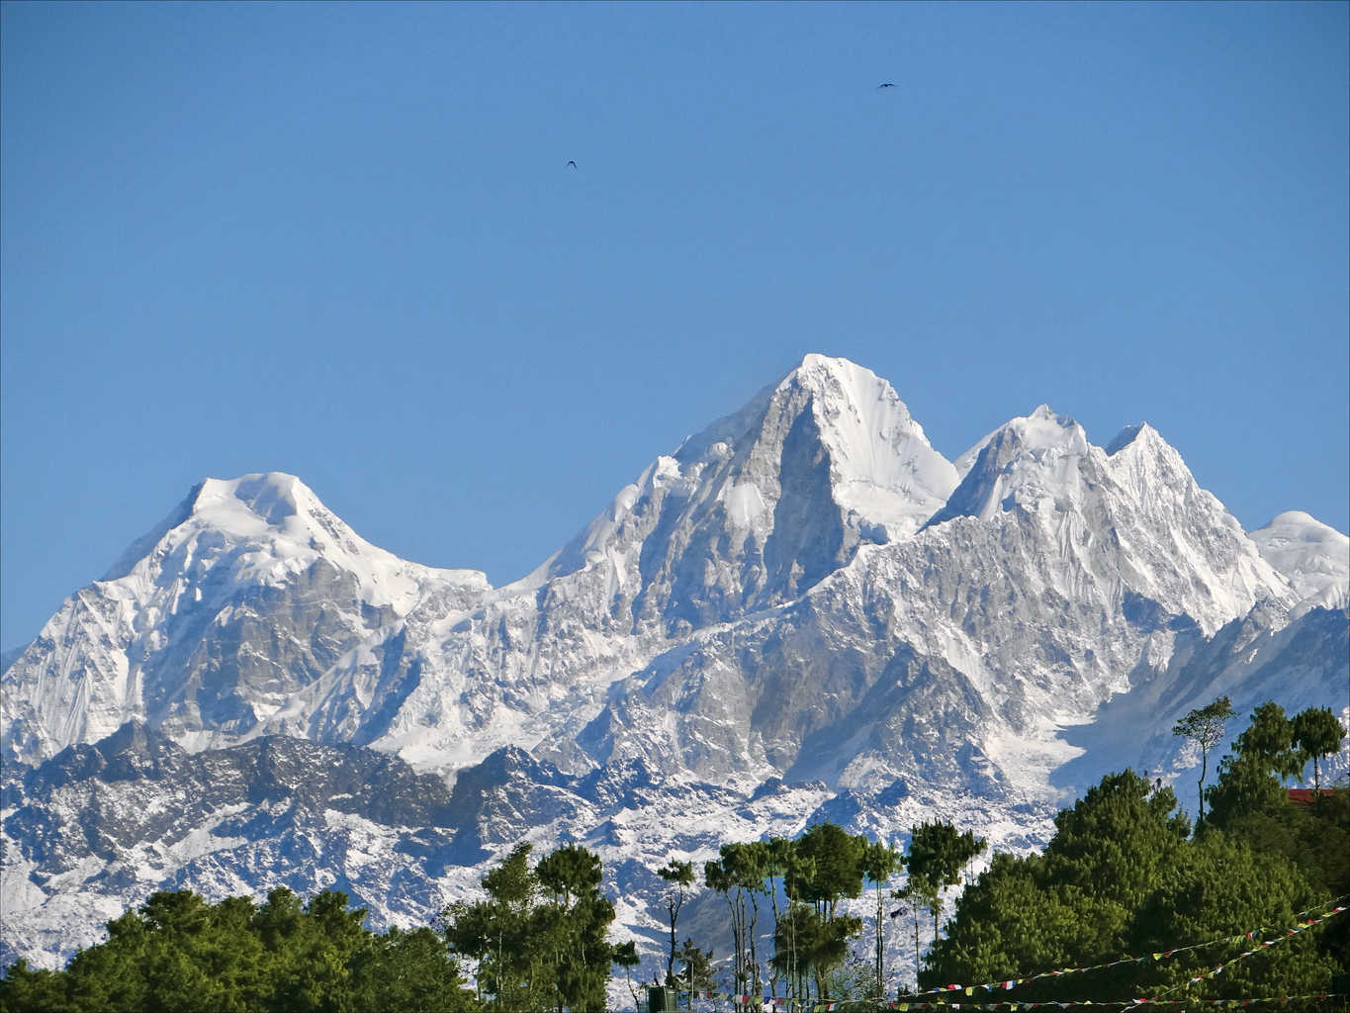
Rugged landscape

Slide 27
Adaptive peak shift

Slide 28
SIM & rugged landscapes
Increasing the mutation rate in individuals below both peaks
High mutation rate
Low mutation rate

Slide 29
Model
https://github.com/yoavram/ruggedsim
Ram & Hadany, PRSB 2014

Slide 30
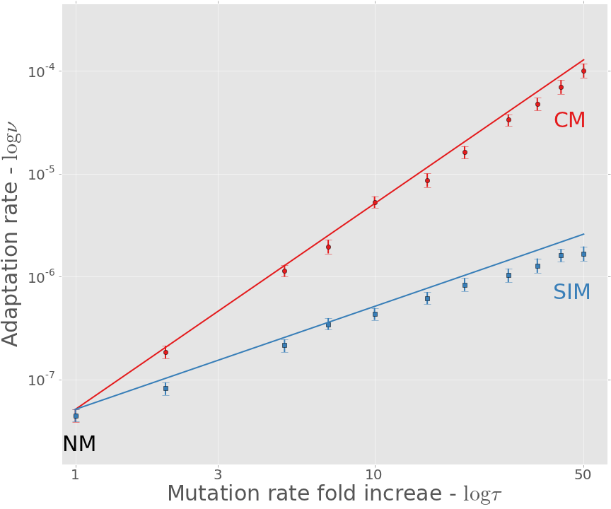

Adaptation rate
https://github.com/yoavram/ruggedsim
$$ν_{CM}≈τ^{2}∙ν_{NM}$$
$$ν_{SIM}≈τ∙ν_{NM}$$
Approximation
Simulation
Ram & Hadany, PRSB 2014

Slide 31
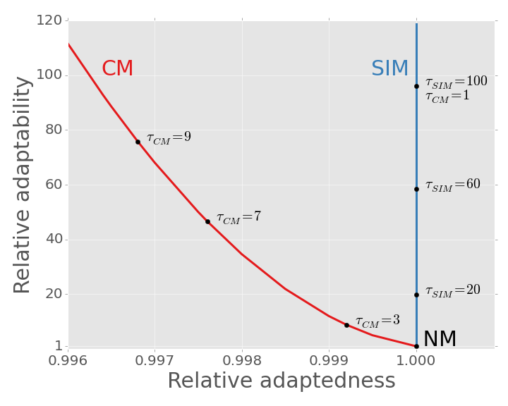
SIM Breaks the adaptability-adaptedness trade-off
Ram & Hadany, PRSB 2014

Slide 32
Conclusions
Effects of stress-induced mutagenesis:
SIM increases the adaptation rate without reducing the population mean fitness
Breaks the trade-off between adaptability and adaptedness
Ram & Hadany, PRSB 2014

Slide 33
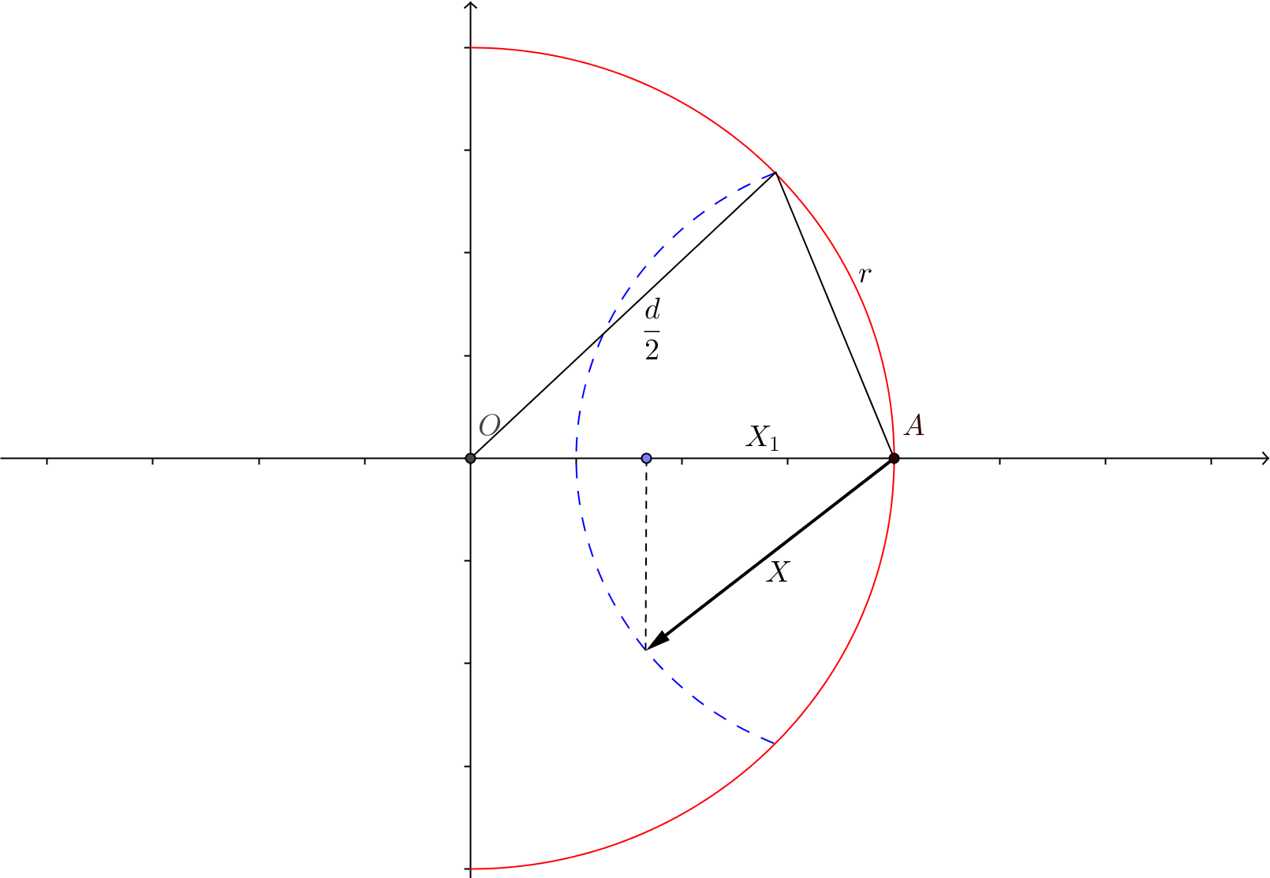
The probability for beneficial mutations in Fisher's geometric model

Slide 34
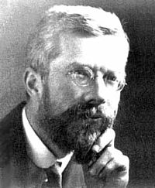
Introduction
Fisher introduced his “geometric model” in page 32 of the book The Genetical Theory of Natural Selection
Adaptive evolution
Phenotype space, n traits
Pleiotropic mutation

Slide 35
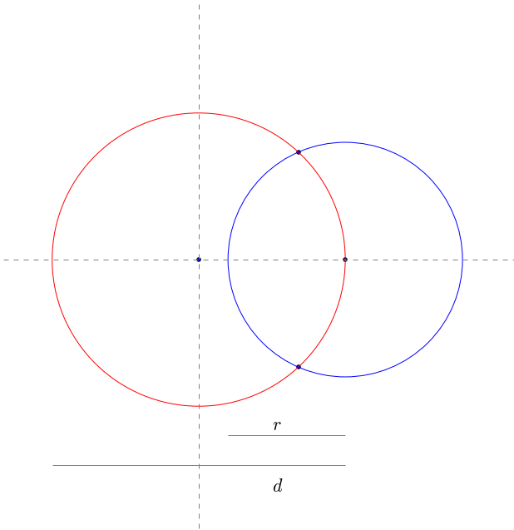
Fisher’s geometric model in 2D
all possible
mutants
phenotypes with
same fitness
Optimal
phenotype
mutants
with
higher
fitness
Current
phenotype

Slide 36
Fisher’s geometric model in 2D
What is the probability that a mutation improves the phenotype?

Slide 37
Fisher’s geometric model in 2D
What is the probability that a random point on the blue circle will be inside the red circle?

Slide 38
Fisher’s geometric model in 2D
The fraction of the blue circle that is inside the red circle

Slide 39
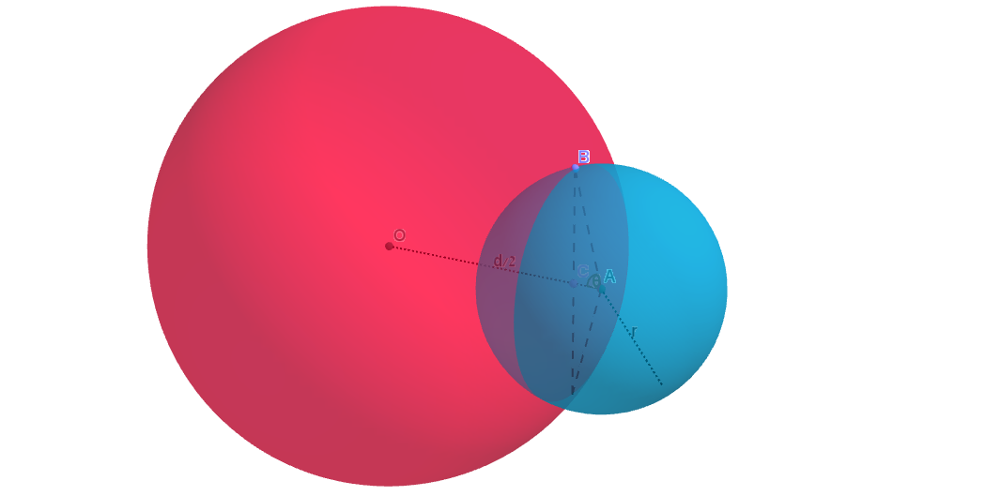
Fisher’s geometric model in 3D
The fraction of the blue sphere that is inside the red sphere

Slide 40
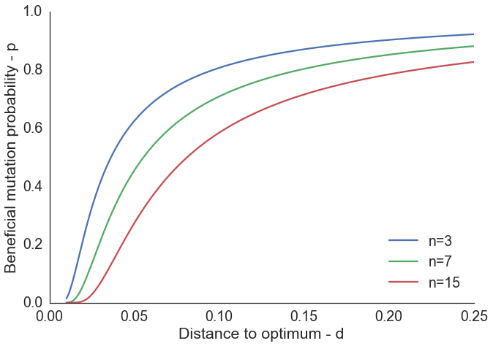
Probability for beneficial mutations

Slide 41
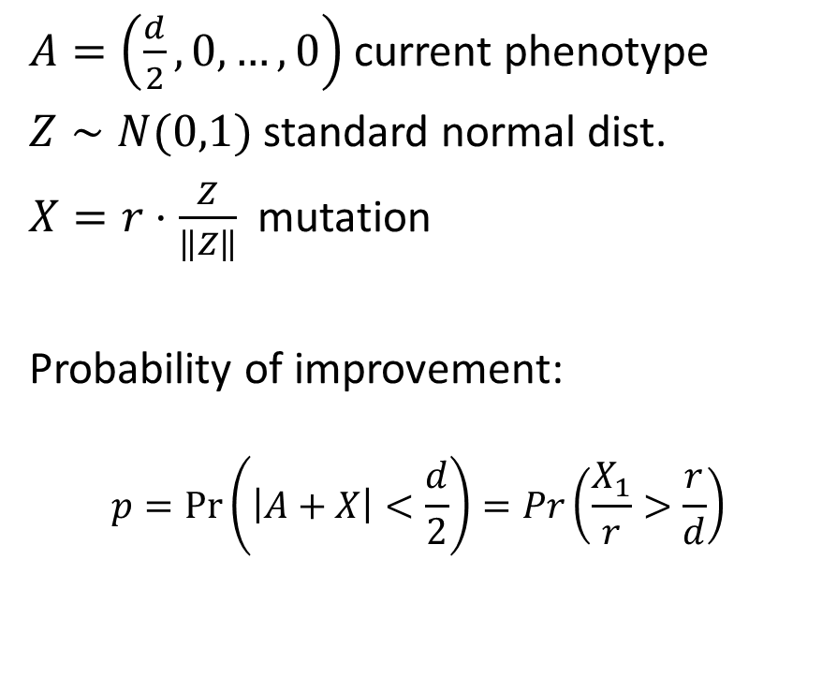
New probabilistic approach
$A=\left(\frac{d}{2},0,…,0\right)$ current phenotype
$Z∼N(0,1)$ standard normal dist.
$X=r⋅\frac{Z}{\left\|Z\right\|}$ mutation
Probability of improvement:
$$p=\operatorname{Pr}\left(\left|A+X\right|<\frac{d}{2}\right)=Pr\left(\frac{X_{1}}{r}>\frac{r}{d}\right)$$
Ram & Hadany, TPB 2015

Slide 42
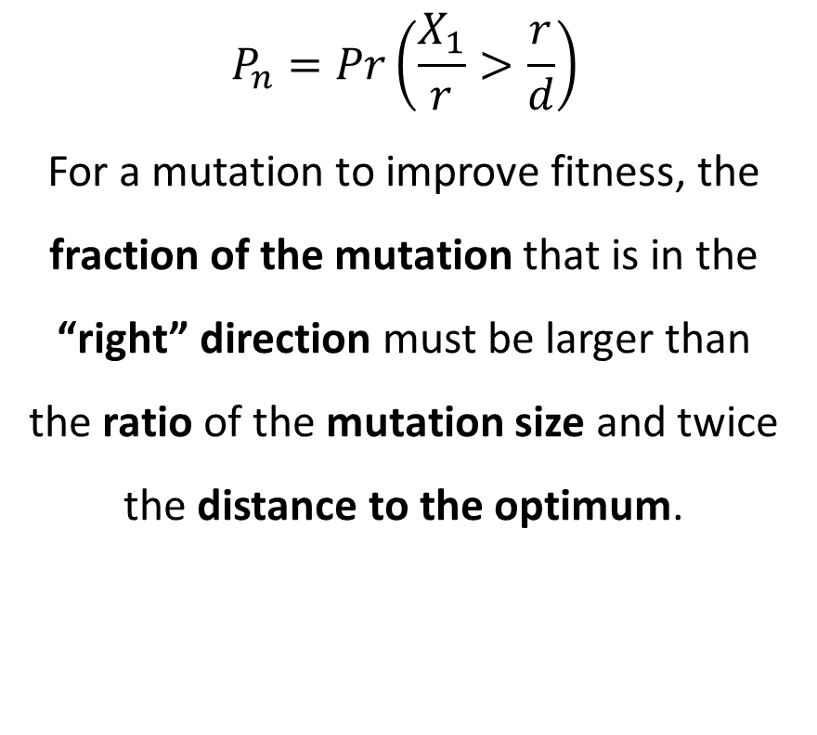
New intuition
$$P_{n}=Pr\left(\frac{X_{1}}{r}>\frac{r}{d}\right)$$
For a mutation to improve fitness, the fraction of the mutation that is in the “right” direction must be larger than the ratio of the mutation size and twice the distance to the optimum.
Ram & Hadany, TPB 2015

Slide 43
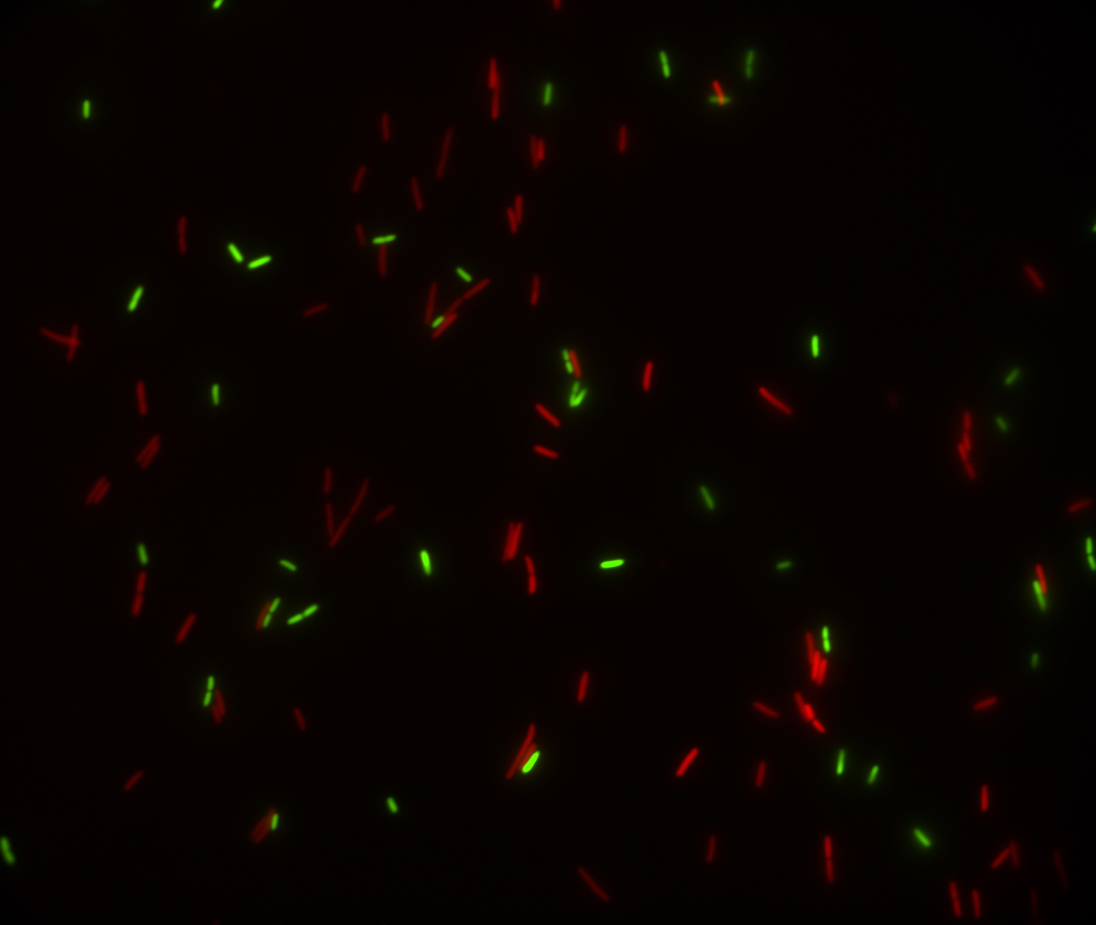
Predicting microbial growth in a mixed culture

Slide 44
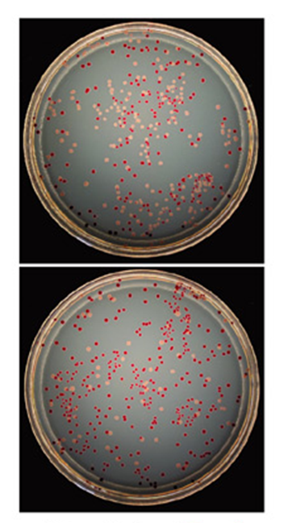
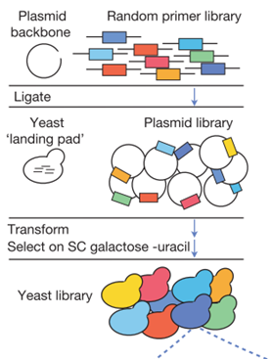
Competition experiments
Strains must have a genotypic or phenotypic marker.
Problem: Laborious and costly, more so for non-model organisms.
Our Solution: Computational framework that predicts growth in mixed culture:
Fit growth models to growth curves
Predict competition results
Infer fitness
Ara⁻
Ara⁺

Slide 45
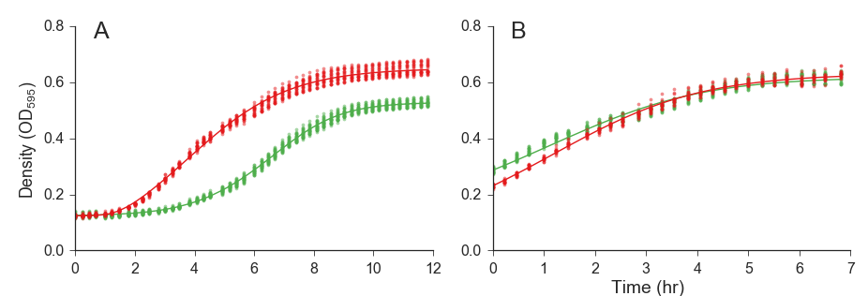
Growth curve data
Data from two experiments with E. coli strains: (DH5α vs. TG1) fitted a growth model
Baranyi & Roberts, 1994
with lag phase
without lag phase

Slide 46
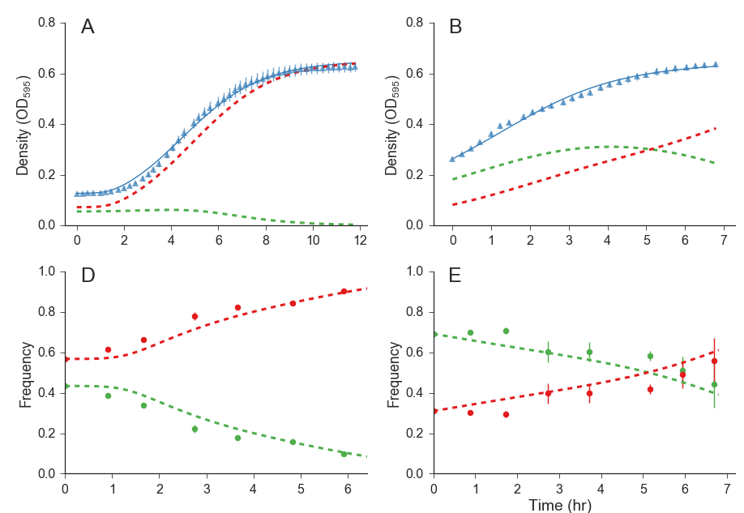

Mixed culture prediction

Slide 47
Summary
Fit growth models to growth curves
Use growth models to predict growth in mixed culture
Use prediction to infer relative fitness
Focus on resource competition
Preprint:
Ram et al. (2015) Predicting competition results from growth curves. bioRxiv, doi:10.1101/022640
Software website: curveball.yoavram.com

Slide 48
Future directions
Complex growth curves:
Bi-phasic growth:
Deep stationary phase
Cell death
Null model for detection of frequency-dependent interactions:
Cooperation
Interference
Compete hypothetical strains
Predict adaptive evolution
Interpret fitness differences

Slide 49
Summary
Stress-induced mutagenesis
Can evolve due to 2nd order selection:
In constant & changing environments
In asexual populations
Ram & Hadany, Evolution 2012
In the presence of rare recombination
Ram & Hadany, in preparation
Increases the rate of complex adaptation rate
Without reducing the population mean fitness
Breaks the trade-off between adaptability and adaptedness
Ram & Hadany, PRSB 2014
New approach to Fisher’s geometric model
Ram & Hadany, TPB 2015
Predicting microbial growth in a mixed culture
Ram et al., bioRxiv preprint

Slide 50

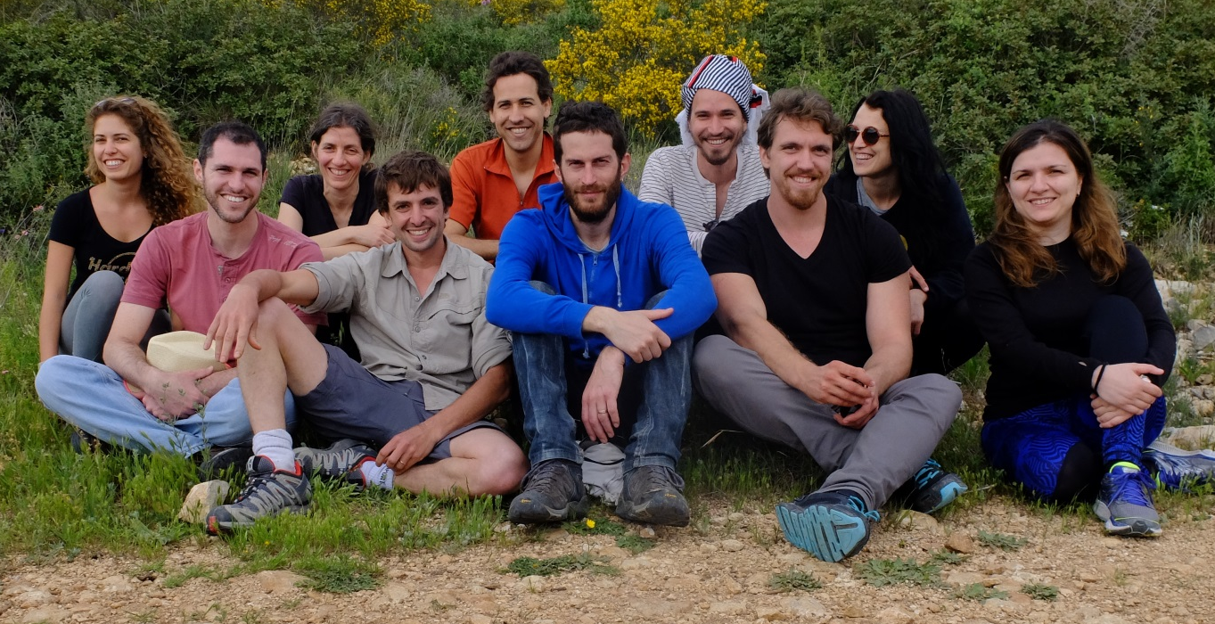




Acknowledgments
Lilach Hadany
Uri Obolski
Eynat Dellus-Gur
Ariel Guiejman
Eyal Zinger
Itzhak Khait
Ohad Lewin-Epstein
Marine Veits
Michael Fishman
Judith Berman
Maayan Bibi
Ella Shtifman Segal
Noa Wertheimer
Alex Rosenberg
Adi Zisman
Feng Yang
Yitzhak Pilpel
Orna Dahan
Dorit Hizi
Itamar Françoise
Idan Frumkin
Avihu Yona
Israeli Ministry
of Science & Technology
The Anat Karuskopf Fund

